Slide 1
Year 9 2020 St Patrick’s College

Slide 2
What you should have…
2020 Year 9 Information Booklet
2020 Year 9 Subject Selection Guide
Parents will be emailed both
Put your name and Year 8 Pastoral Group on each

Slide 3
What questions would you
like answered today?

Slide 4
Year 9
The Year 9 timetable is aligned with the Senior School
Based on a combination of core and elective subjects
This structure allows you to build and extend on what you have learnt in Year 8

Slide 5
Year 9
The Year 9 elective offerings come from four disciplines:
- Computing - HaPE
- Technology - The Arts
Provide opportunities to become independent and active learners

Slide 6
Year 9 core subjects
Religious Education (6 pers p/ft)
English (10 periods p/ft)
Mathematics (10 periods p/ft)
Humanities (10 periods p/ft)
Science (10 periods p/ft)
PE (4 periods p/ft)

Slide 7
Year 9 core subjects
Literacy (8 periods p/ft)
Rite Journey (2 periods p/ft)
Community Service (2 p/ft)
Pastoral Care (2 periods p/ft)

Slide 8
Religious Education
Common course done by all Year 9 students
Religious Education is compulsory for all students at St Patrick’s College

Slide 9
English studies
Study one of two class groupings - Foundation English and English
Which will depend on your level of literacy (based on your internal and external Year 7 and Year 8 literacy testing results)

Slide 10
English studies
Subject to further development in your level of literacy and your literacy testing results, you may be able move between one ability-based class and another.
Letter to be sent to your parents as to which English study your teachers have identified for you.

Slide 11
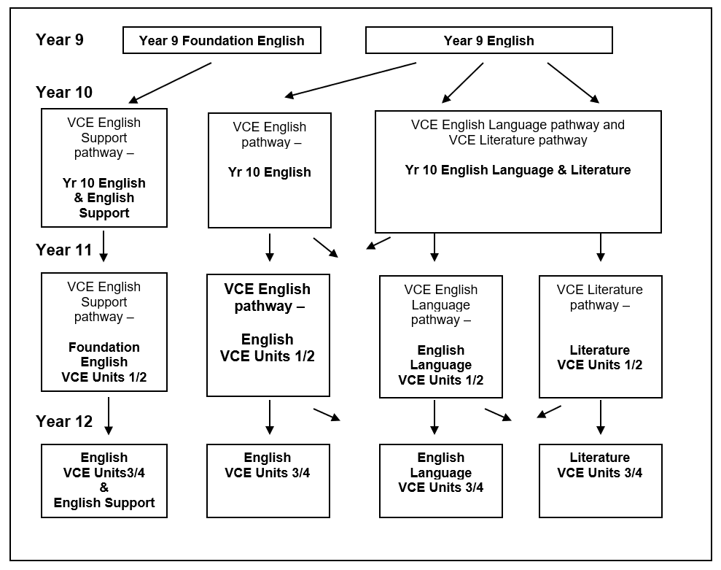
English pathways

Slide 13
Mathematics studies
Study one of three class groupings – Foundation, Pre-General Pre-Methods
Which will depend on your level of numeracy (based on your internal and external Year 7 and Year 8 numeracy testing results)

Slide 14
Mathematics studies
Subject to further development in your level of numeracy and your testing results, you may be able move between one ability-based class and another.
Letter to be sent to your parents as to which Maths study your teachers have identified for you.

Slide 15
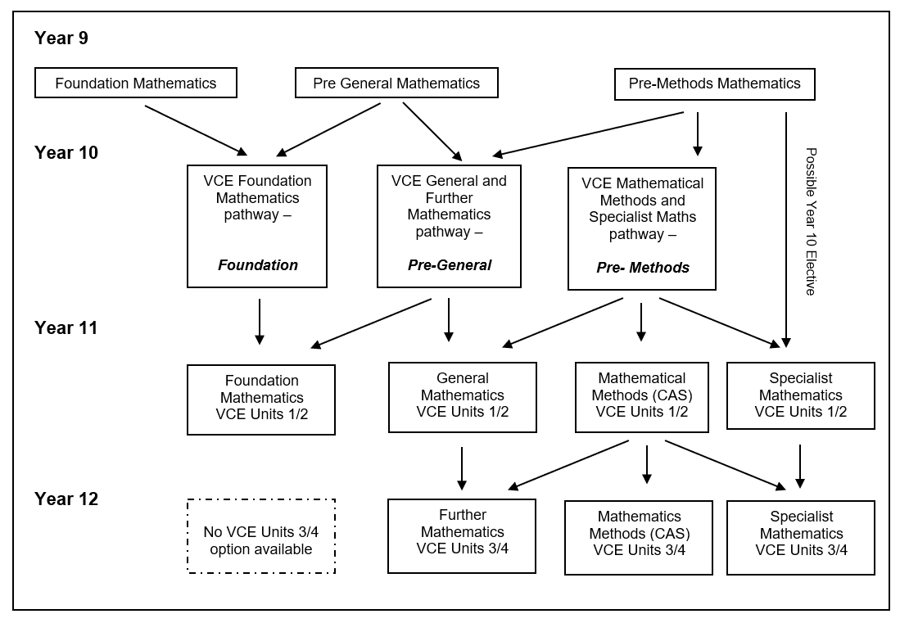
Mathematics pathways

Slide 17
Science and Humanities
Common courses done by all Year 9 students
Both are compulsory for all students at St Patrick’s College through to Year 10
Both include an introduction to the Senior School studies

Slide 18
Physical Education
Based on SEPEP - Sport Education in Physical Education Programme
Requires you to not only to be physically active but also to be part of the administration, coaching, officiating and publicity aspects the competitions

Slide 19
Physical Education
SEPEP programmes will run in the following sports:
Term 1 - European Handball
Term 2 - Basketball
Term 3 - International Rules Football and Touch Rugby
Term 4 - Fitness and Softcrosse

Slide 20
Literacy
Opportunity to study one of:
Japanese (VET Cert II in Applied Languages)
Literacy Support or,
Literacy Development
8 periods per fortnight

Slide 21
Option 1: Japanese
Students wanting to continue their study of Japanese will do by studying VET Certificate II in Applied Languages (Japanese)
Year 9 is the first year of this two-year certificate
The program is year-long.

Slide 22
Option 1: Japanese
The course emphasises the use of real, meaningful language to complete activities such as describing familiar people and places and providing information about familiar topics.
It uses competency based assessment

Slide 23
Option 2: Literacy Support
Targeted intervention program to support boys who will benefit from the teaching of explicit literacy skills to support their studies in a range of Year 9 subject areas (and, in particular, the study of English).

Slide 24
Option 2: Literacy Support
Students are usually invited to join the Literacy Support program, however, in some circumstances students who have not completed the Years 7 and/or 8 Linguistics programs have joined the group after consultation

Slide 25
Option 3: Literacy Development
Opportunity to extend knowledge and experience of a range of literacy genres that can be applied in other subject areas.

Slide 26
Option 3: Literacy Development
Can select from the following in 2020:
Art, Design and Architecture
Computer Coding
Film and Media
Literature and English Language
Mathematical Problem-Solving
Philosophy
Scientific Investigation and Thinking

Slide 27
Electives
Refer to pages 21-35
Each elective subject is allocated eight periods per fortnight
Each elective is a semester-length subject which is repeated in Semester Two

Slide 28
Electives
You can only study an elective once for the year
Should aim to select electives from two of the disciplines
Not all electives listed will run.

Slide 29
Other aspects of Year 9
Mr Busscher
Director of the Middle School

Slide 30
The Rite Journey
The Rite Journey is a year-long pastoral care programme
The Rite Journey is designed to support the development of young adults as self-aware, vital, responsible, respectful and resilient

Slide 31
The Rite Journey
Focus on raising each student’s consciousness about transitioning from boy to young adult and having conversations about what really matters.

Slide 32
Community Service
Community service is when you work to the benefit of your community rather than yourself.
In our modern world, we need to consider community service not only as a local opportunity but, one that has the potential to recognise and meet global needs.

Slide 33
Community Service
Community service benefits:
Your personal development
Your awareness of social justice issues
The community
You future career/professional interests
St Patrick’s College

Slide 34
Community Service
Vast range of choices offered
Your Community Service placement will last for the entire Semester One and then change in Semester Two, just like the Year 9 Electives. If it is possible, I suggest two significantly different experiences be undertaken, as this will provide a greater breadth of experiences for you.

Slide 35
Community Service
You will be sent a link to register your preferred Community Service choices. This is similar to the process used when selecting the 2020 electives.
This will be done when we start school in 2020, following a letter sent home to your parents at the end of 2019 and a Parent Information Evening at the start of 2020.

Slide 36
Student Perspective
Japanese (Mitchel and Nyjo)
Literacy Support (Cooper)
Literacy Development (Harrison)
Community Service (Ben)

Slide 37
Beyond Year 9
Mr Hill
Acting Co Headmaster
Teaching and Learning

Slide 38
Beyond Year 9
What you do in Year 9 is important because it will impact on the knowledge, skills and work habits you bring with you into the Senior School

Slide 39
Beyond Year 9
One significant example of this is a student’s level of preparedness to do a VCE Units 1/2 study or VET certificate as a Year 10 student.

Slide 40
Beyond Year 9
To do this you must meet certain criteria such as:
Be receiving graded performances of 80% plus in the relevant Year 9 subject(s).
Have a high level of classroom organisational skills

Slide 41
Beyond Year 9
Complete all home work and study tasks promptly
Display a high level of classroom behaviour
Submit all tasks on time
Construct and submit a portfolio of work

Slide 42
Which electives should I do?
What are you enjoying in Year 8?
What subjects are you doing well in?

Slide 43
I shouldn’t do electives…
Just because my friends are
Because I like the teacher who taught the subject this year
Because I think they’ll be easy

Slide 44
As you read through the booklet….
Rank or rate your interest in each eg.
✓ ✓ ✓ really want to do
✓ might be interesting
? need to find out more
✗ definitely not

Slide 45
The Subject Selection Guide

Slide 46
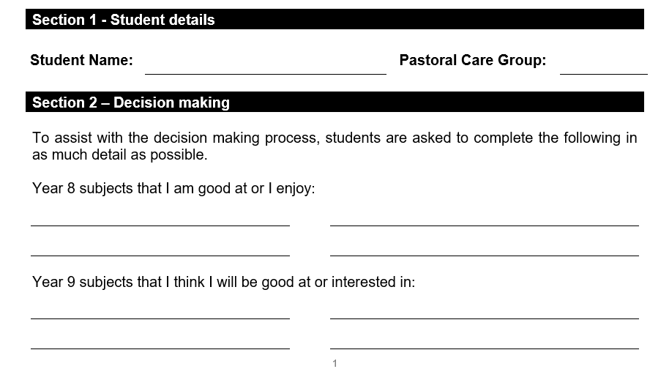

Slide 47
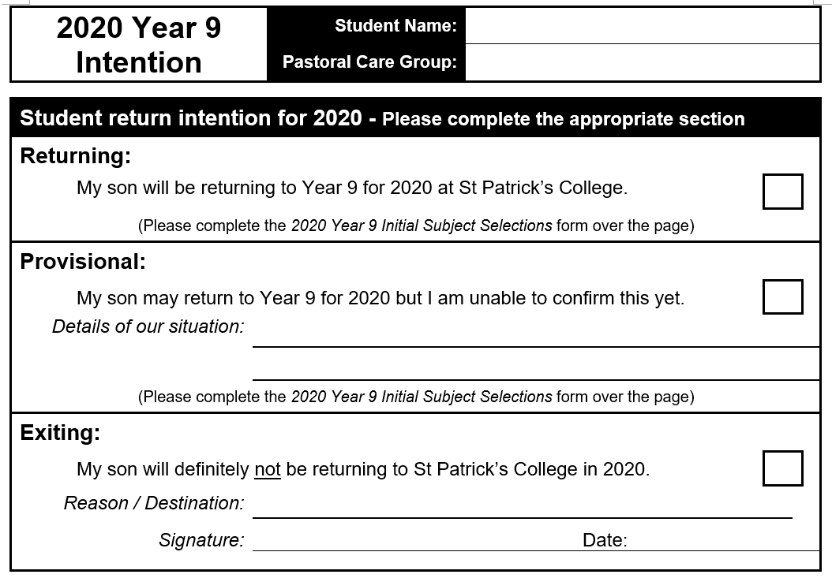

Slide 48
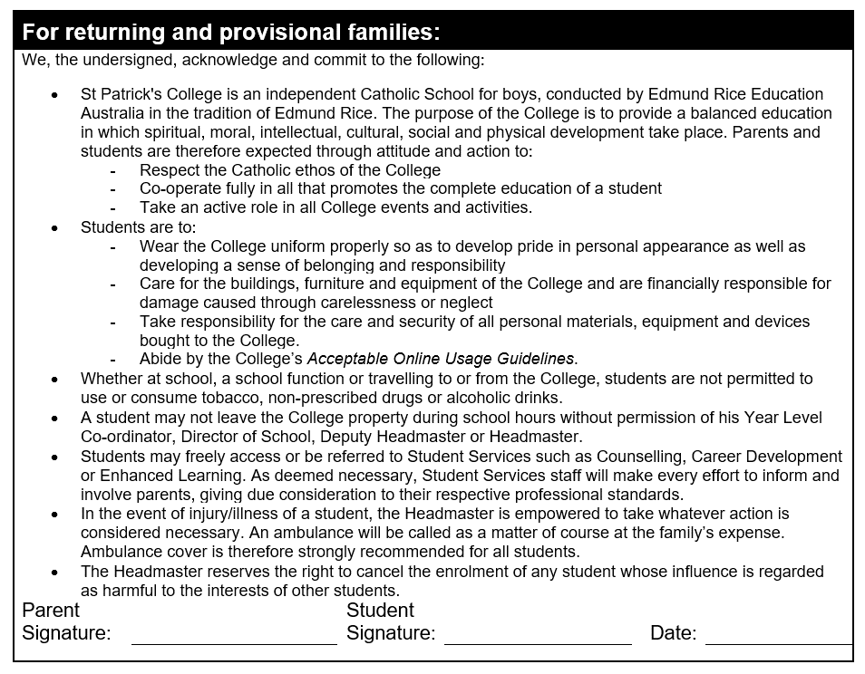

Slide 49
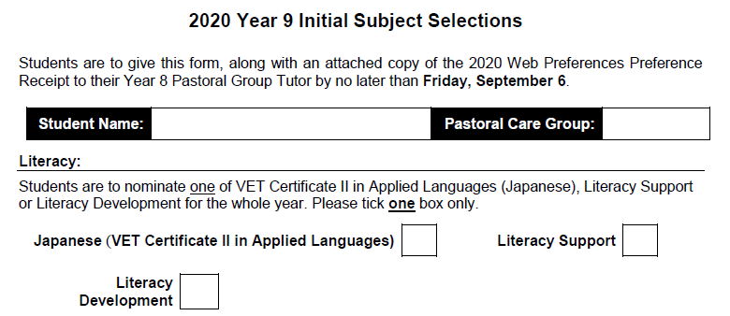
✓
Move to next “Electives” section

Slide 50
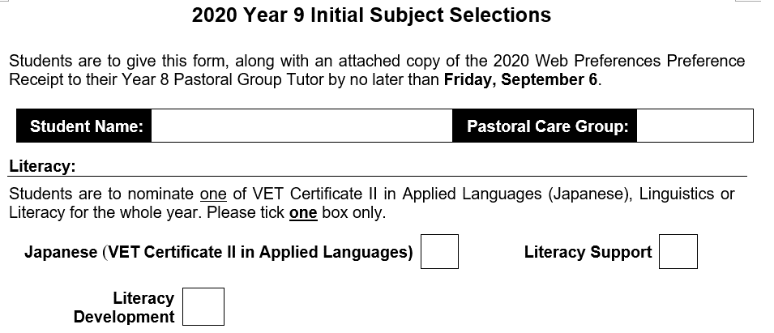
✓
Move to next “Electives” section

Slide 51
✓
Nominate offerings from 1 to 7

Slide 52
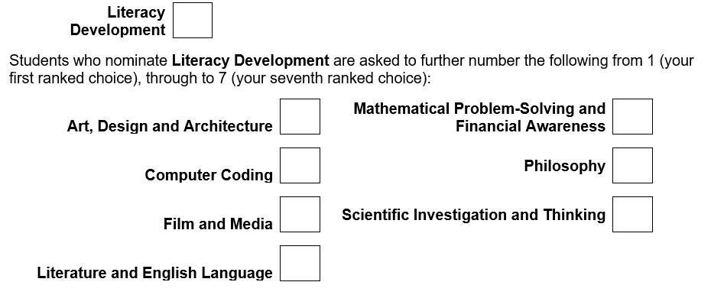
✓
6
7
1
5
2
3
4

Slide 53
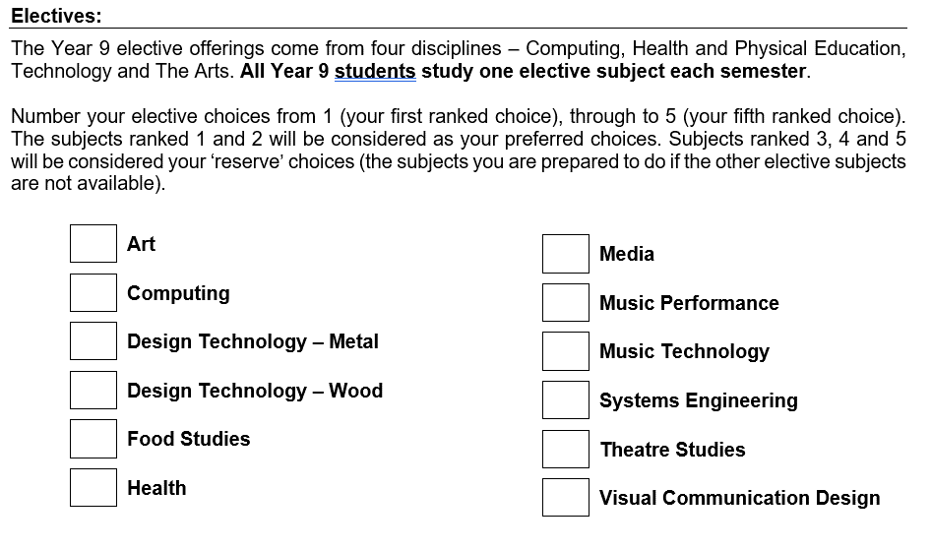
1
2
3
4
5

Slide 54
Where to now ?
Read through the booklet thoroughly
Rank/rate your choices as you do so
Discuss possible choices
If unsure about any aspect ask questions

Slide 55
Where to now ?
Complete selection sheet
Hand it in to your Pastoral Group Tutor along with a printed and signed copy of the 2020 Web Preferences Preference Receipt by no later than Friday, September 6

Slide 56
Online submission of proposed 2020 Year 9 studies
You are required to submit your 2020 Year 9 course of study and program details using Web Preferences (the online subject submission portal).
Mr Ferguson will email you a link to Web Preferences, along with detailed instructions.

Slide 57
Online submission of proposed 2020 Year 9 studies
Your parents will also be sent a similar email explaining the submission procedure.
Please note: A parent and student signed copy of the 2020 Web Preferences Preference Receipt is to be submitted with this Subject Selection Guide.

Slide 58
Where to now ?
Complete selection sheet, attach a signed copy of your 2020 Web Preferences Preference Receipt and hand both documents to your Pastoral Group Tutor by no later than Friday, September 6
No parent information evening this year. This will take place early in 2020.

Slide 59
Questions

Slide 60
Year 9 2020 St Patrick’s College

