Slide 1
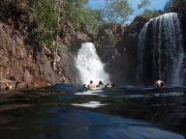
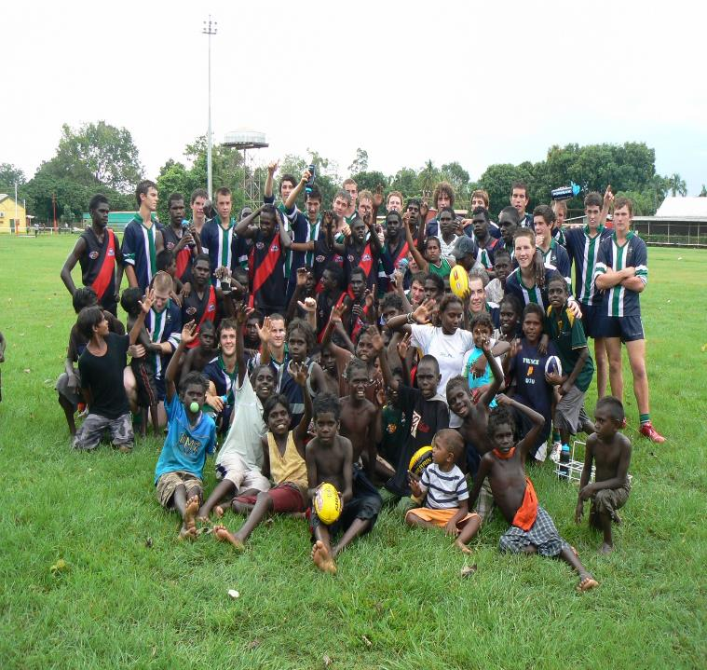
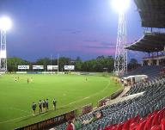
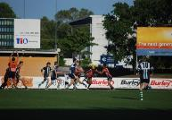
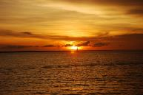
St Patrick’s College Tour of Darwin 2020
Monday March 30 – Tuesday April 7

Slide 2
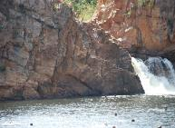
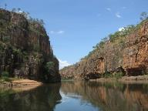
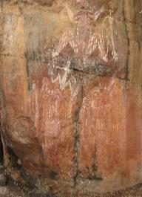
Tonight’s Meeting
MC – Howard Clark
Tour Itinerary – Leonie Spencer
Communication – Howard Clark (Coordinator of Football)
SPC - OCA facebook page
Touring Staff – Howard Clark
Apparel. Howard Clark
Selection Criteria Howard Clark
Cost – Howard Clark
Application Process
Parents and students questions H Clark/L Spencer

Slide 3
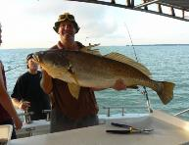
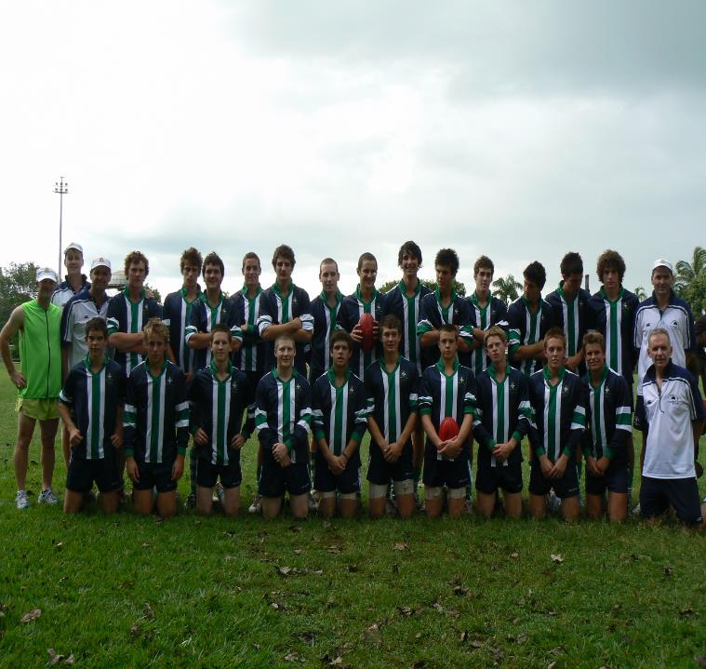
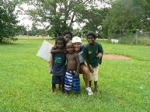
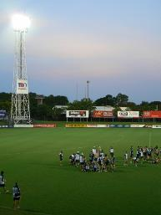
Introduction
St Patrick’s College through its flagship First XVIII football programme is offering an opportunity for students to tour the Northern Territory in the Term 1 holidays in 2020.
This tour, in line with the football strategic plan follows successful trips to Ireland (2007, 2010,2013 & 2016, 2019), Darwin (2008, 2011 & 2014, 2017) and Melbourne (2006, 2009, 2012 & 2015, 2018)
The tour aims to visit a number of significant Indigenous sites and play a series of 3 games against the Darwin based U/18 & U/16 Academy Team’s, St Mary’s’s Darwin and an exhibition game on Bathurst Island located in the TIWI islands.

Slide 4
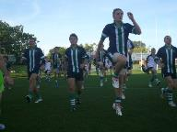
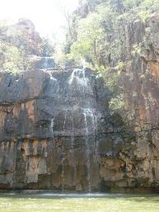
Itinerary
Places of Interest
Darwin Territory Park
Litchfield National Park
Tiwi Islands
Activities
AFL Indigenous Clinics
Half Day Fishing Tour
Jumping Crocodiles on the Adelaide River
Personal Training session at Richmond Barracks
Football Games
SPC v NT U/16 & U/18 Academy
SPC v St Mary’s
SPC V Bathurst Island

Slide 5
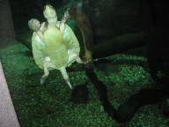
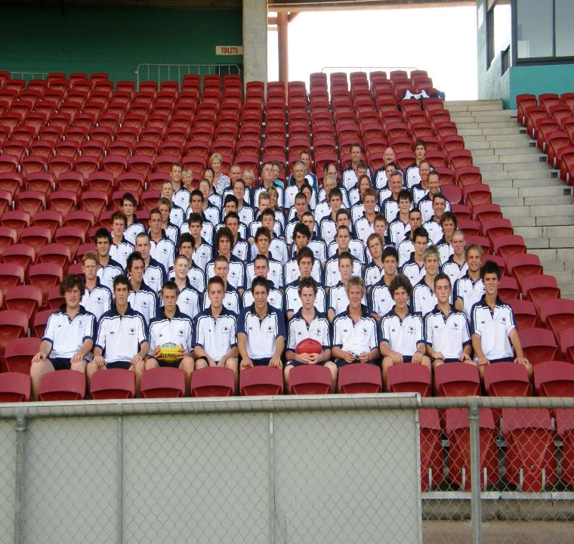
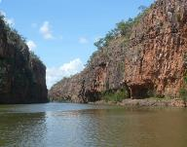
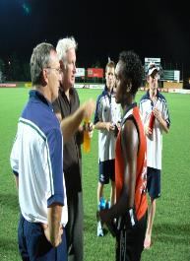
Communication

Slide 6
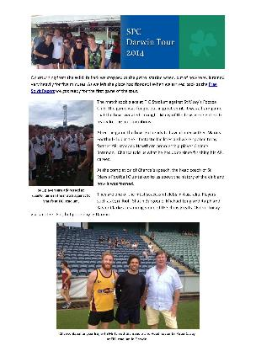
Communication
A daily email will be sent to parents from Lorrie Liston while pictures will all be posted on the SPC-OCA Facebook page.
https://www.facebook.com/spcoca/

Slide 7
Touring Staff
E Ryan - Tour Director
H Clark – Coordinator of Football/Coach
S Biggin– 1st XVIII Coach
M Miller – 2nd XVIII Coach
L Davie – Assistant Coach
P Ryan- Logistics
L Liston– Communication
C Flynn – Physiotherapist

Slide 8
Medical
Dr Charlie Flynn (Newington Physiotherapy) will be the accompanying medical practionier on tour
Any medical emergency will be handled by the Darwin BASE Hospital

Slide 9
Apparel
College Shop
Touring Cap (SPC Sports Cap)
Back Pack (provided)
SPC Playing Jumper
SPC Blue Shorts
Green and White Hooped Socks
SPC Blue Sports Top
SPC Sports Shorts

Slide 10
Jumper Design
Th
This painting represents togetherness and going on a journey on the same path, with one common cause, all from different backgrounds.
Amunda Gorey (Artist – SPC Parent 2014)

Slide 11
Selection Criteria
Students with a demonstrated record of participation within the College’s current football programme from Year 9-11. Boarding students entering the College at Year 10, 11 or 12 will be considered for the tour in line with commitment to football at their previous school and upon analysis of their tour application
Commitment to play school football for at least Term two in 2020
Represented the College at 1st XVIII level
AIS/AFL Academy programme members
Previous State Representative in either U/15, U/16 or U/18 levels
Current U/18 NAB squad members
Current U/16 NAB squad members
Community interleague representative
The Headmaster will have discretion to select or omit students for the tour in light of circumstances communicated to him in confidence.

Slide 12
Fundraising
Film Evening – Regent Theatre
(Date to be announced)

Slide 13
Cost
$2850

Slide 14
Application Process
Survey Monkey: On line Application
https://www.surveymonkey.com/r/darwin2020

Slide 15
Key Dates
Wednesday, August 7 – Applications Open (On Line)
Friday, August 30 – Applications close
Friday, September 13 – Successful Applications Announced
(Subject to Approval by finance department)

Slide 16
Payment Schedule
Wednesday, September 18, Tour Deposit ($1000)
Friday, November 8,
1st Instalment ($1000)
Friday, February 7,
Final Instalment ($850)

Slide 17
Question and Answers
Mr Howard Clark
Mrs Leonie Spencer

Slide 18
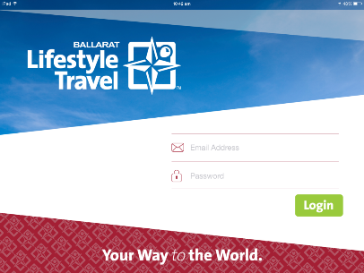
Prepared By
Lifestyle Travel MyTrips App
We are pleased to offer you the service of our new Smart Device App called MyTrips
This app allows you the flexibility to have all of your travel arrangements on your smart device.
Available for both iOS & Android.

Slide 19
Prepared By
Lifestyle Travel MyTrips App
Go to app store/play store and search MyTrips
Download the MyTrips app. The icon will be our compass logo as shown in the top right hand corner of this slide.
Once downloaded you will need to sign into the app
Username: (Personal School Email)
Password: (surname1)
Once you have signed in, the app will synchronise all of your information and will be visible. Tabs include
Docs - Housing your Full Itinerary, Travel Insurance Information, Currency Conversions and E Tickets
Guides - Specific Travel Information personalised to the Cities and Countries you are travelling to
Messages - Direct communication with Lifestyle Travel Ballarat
Maps - Offline Maps (Download prior to departure) that do not require internet to be viewed
Info - Create your own packing check list or keep a travel journal throughout your trip

